Slide 1

Implementing Row-Level Security (RLS) in Power BI.

Slide 2
What is Row-Level Security (RLS) in Power BI?
RLS controls data visibility at the row level, ensuring that users only see data relevant to their role or access level.

Slide 3
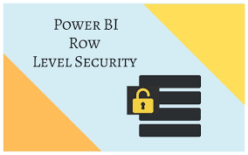
Purpose of RLS:
Data Confidentiality: Limits access to sensitive information.
Custom Access: Provides tailored data views for different users within a single data model.
Key Use Cases:
Restricting data based on geography (e.g., regional managers see data only for their region).
Limiting access by department (e.g., only finance can see financial data).

Slide 4
Benefits of Implementing RLS in Power BI
Enhanced Data Security:
Protects sensitive information by limiting data access to authorized users.
Centralized Report Management:
A single report can serve multiple user groups, each seeing only the data they are permitted to view.
Improved Performance:
RLS can help optimize performance by limiting the data load for each user, particularly in large datasets.
Simplified Compliance:
Helps meet data governance and compliance requirements by limiting data exposure.

Slide 5
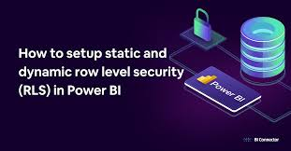
How RLS Works: Roles and Filters
Roles: Defines who can view specific data; roles are assigned to users or groups.
Filters: DAX filters within roles control data visibility.
Static vs. Dynamic RLS:
Static RLS: Predetermined roles with fixed filters, suitable for simpler setups.
Dynamic RLS: Uses DAX functions to dynamically filter data based on user identity, allowing greater flexibility and scalability.

Slide 6
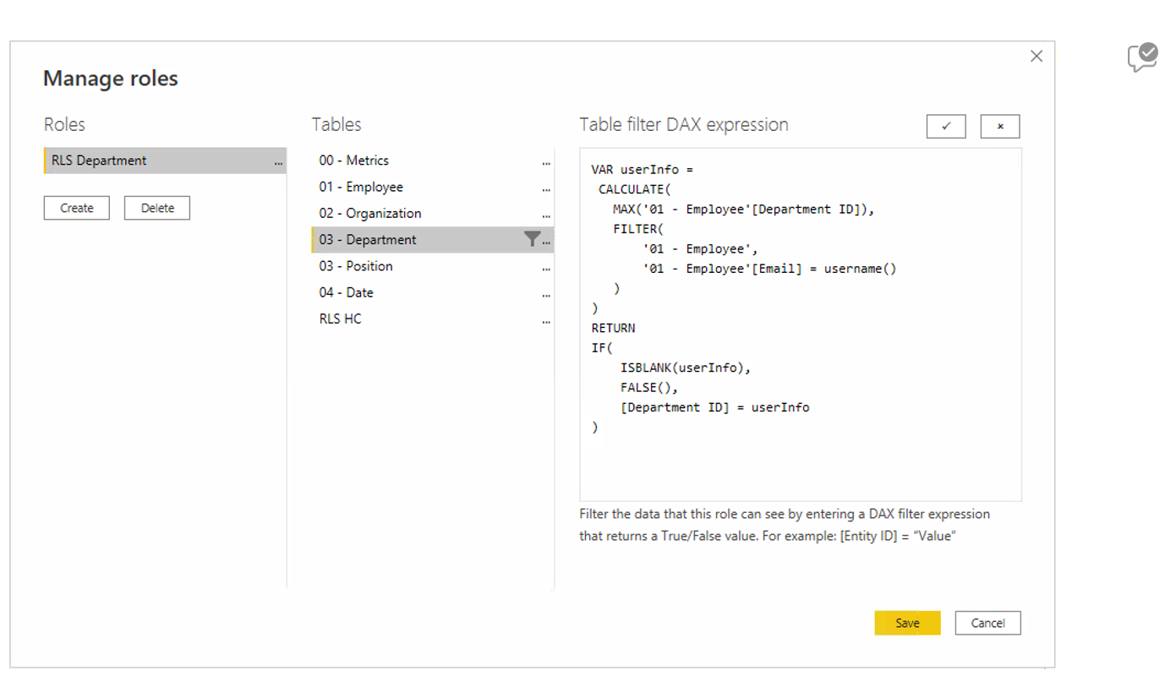
RLS Implementation in Power BI Desktop – Step-by-Step
Define Roles:
Go to Modeling > Manage Roles in Power BI Desktop.
Create roles that define access to specific data based on filters.
Create Filters Using DAX:
Add DAX filter expressions for each role, like [Region] = "North" or [Department] = "Finance".
These filters will control which rows each role can view.
Testing Roles in Power BI Desktop:
Use View as Role to simulate the user experience for each role.
Verify that each role correctly restricts data visibility.

Slide 7
Dynamic Row-Level Security with USERPRINCIPALNAME()
Overview of Dynamic RLS:
Uses DAX to create personalized filters based on the logged-in user’s identity.
Enables one role to be applied across multiple users, with each user seeing only their relevant data.
Using USERPRINCIPALNAME() in DAX:
USERPRINCIPALNAME() function returns the user’s email or username, which can be used to filter data.

Slide 8
Dynamic RLS Implementation – Example
Setting Up the Data Model for Dynamic RLS:
Add a column in your data table that corresponds to the user’s identifier (e.g., email address).
Create a relationship between user information and the dataset.
Example DAX Formula for Dynamic RLS:
[ManagerEmail] = USERPRINCIPALNAME() if you want each manager to see only their team’s data.
Use RELATED() or LOOKUPVALUE() in DAX for more complex data relationships.

Slide 9
Testing and Publishing RLS in Power BI
Testing RLS:
View as Role in Power BI Desktop: Allows you to verify that each role sees only the intended data.
Test with different roles and filters to ensure correct setup.
Publishing the Report to Power BI Service:
Publish the report from Power BI Desktop to the Power BI Service.
Assigning Users to Roles in Power BI Service:
Go to Security settings in Power BI Service.
Assign users or groups to the roles defined in Power BI Desktop.
Only users assigned to roles will have restricted views of the data.

Slide 10
Challenges of Implementing RLS
Maintenance Complexity:
Large numbers of roles or complex DAX filters can make RLS harder to manage.
Performance Implications:
RLS may affect report load times, especially with complex filters or large datasets.
User Confusion:
Users unaware of RLS limitations may mistakenly believe they’re seeing the full dataset.

Slide 11
Best Practices for RLS Implementation
Limit the Number of Roles: Use dynamic RLS where possible to reduce the number of roles.
Use Clear Naming Conventions: Name roles descriptively (e.g., “Regional Manager – North”).
Document RLS Setup: Keep records of role definitions and DAX formulas for maintenance.
Regularly Test RLS: Re-test roles after data model updates to ensure filters still apply as intended.
Performance Testing: Monitor performance, especially in large datasets, and optimize DAX formulas if necessary.

Slide 12
Conclusion
Row-Level Security (RLS) in Power BI is a powerful feature that enables data security by controlling user access at a granular level. Implementing RLS allows organizations to securely manage data visibility, ensuring that each user only sees the information they are permitted to access. By defining roles and applying DAX filters, organizations can create a streamlined, secure reporting environment tailored to various user groups, whether it’s by department, region, or individual. Dynamic RLS further enhances flexibility by applying filters based on user identity, reducing the need for multiple static roles and allowing for scalable solutions. While RLS requires careful planning, testing, and ongoing maintenance, its benefits—such as enhanced data security, compliance support, and improved performance—make it a critical component in Power BI for businesses handling sensitive or compartmentalized data. Embracing RLS can lead to a more efficient, secure, and personalized data experience, empowering users while protecting valuable data assets.

Slide 13
THANK YOU
thahliyamist@gmail.com

